Slide 1
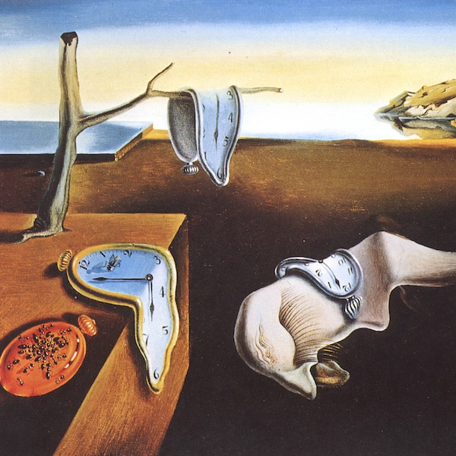
Salvador Dalí, “The Persistence of Memory,” 1931
Privacy Attacks & Defenses
姜育刚，马兴军，吴祖煊

Slide 2
Recap: week 8
Data Extraction Attack & Defense
Model Stealing Attack
Future Research

Slide 3
This Week
Membership Inference Attack
Differential Privacy

Slide 4
Membership Inference Attack
Differential Privacy

Slide 5
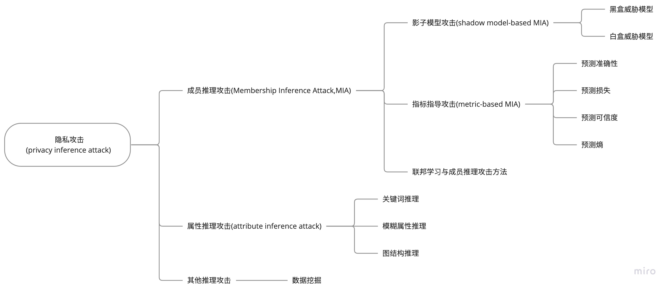
Membership Inference Attack

Slide 6
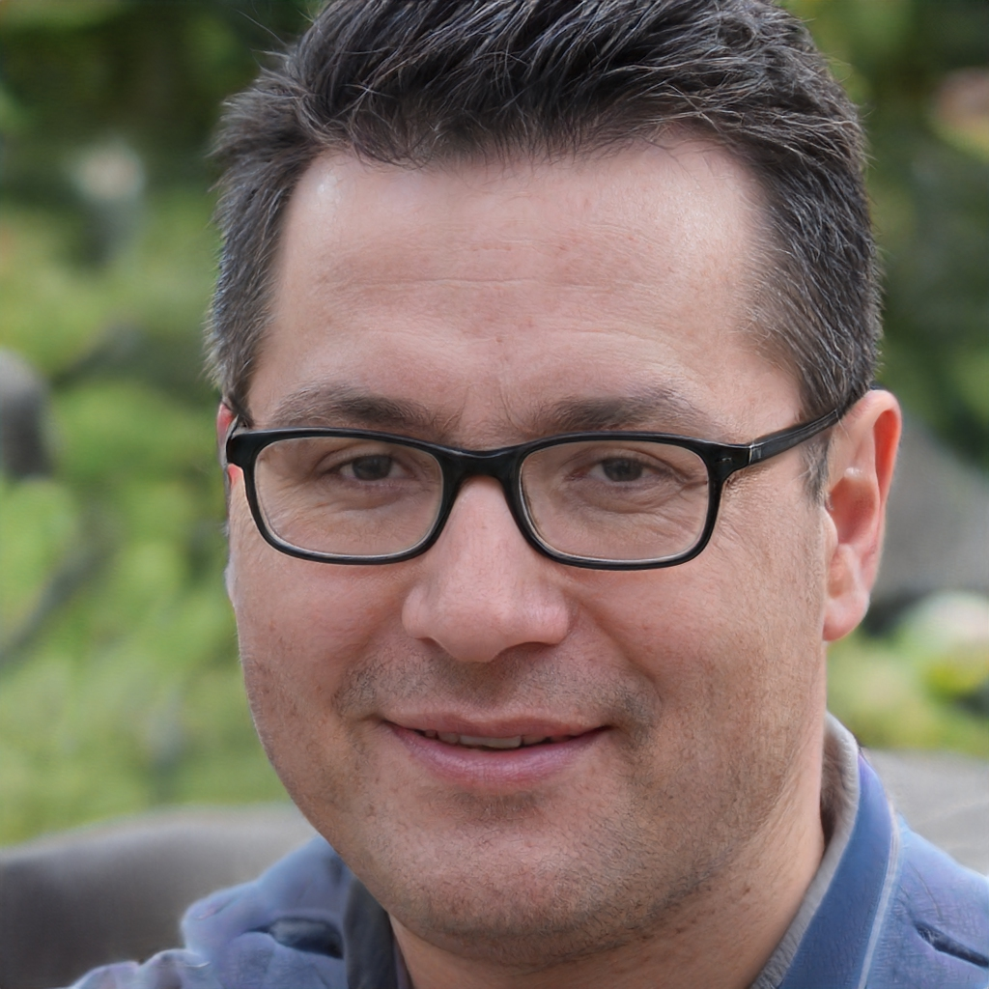
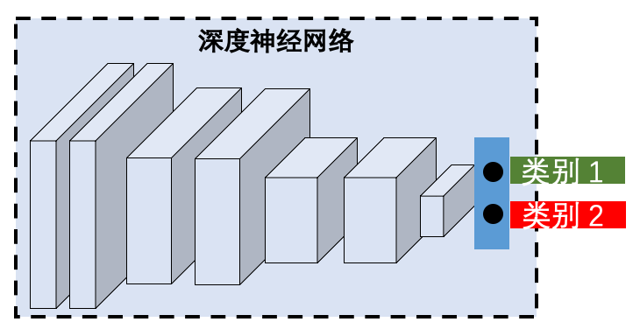
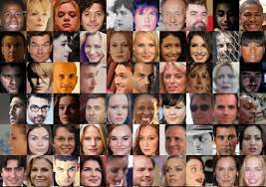
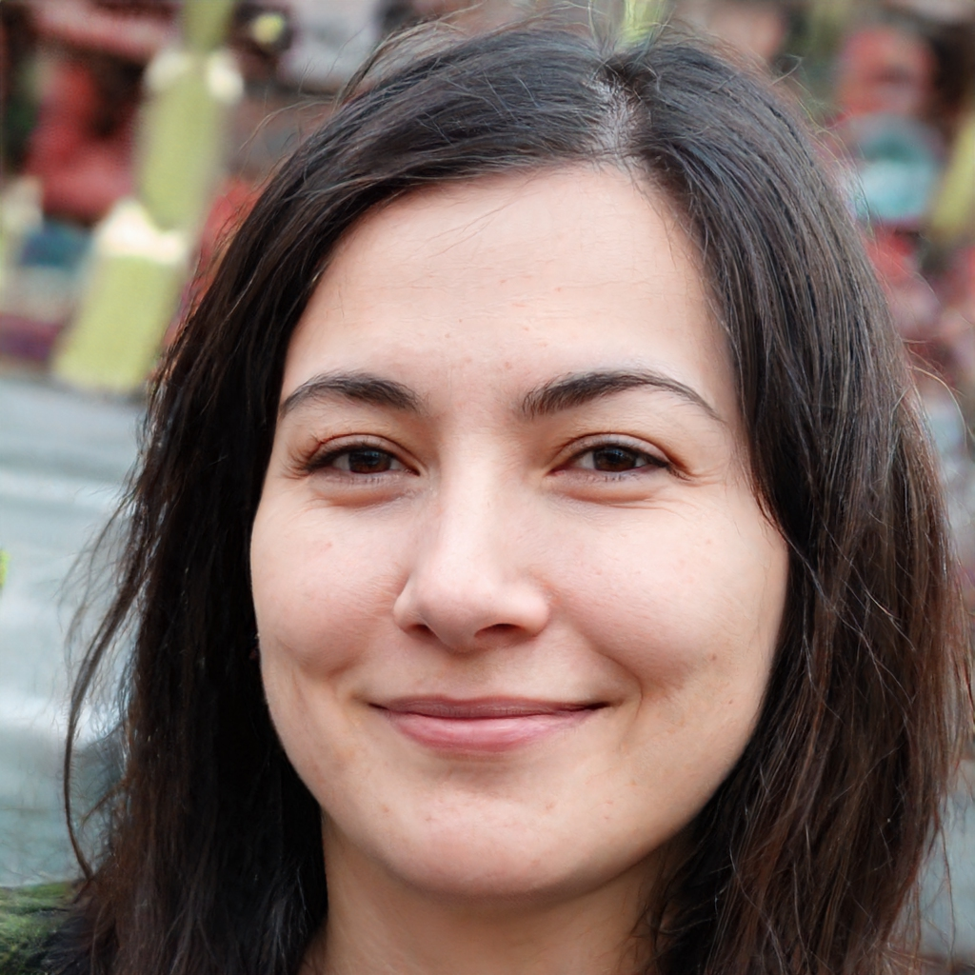
Membership Inference Attack
存在？
推理一个输入样本是否存在于训练数据集中
Shokri, Reza, et al. "Membership inference attacks against machine learning models." S&P, 2017.

Slide 7
Privacy and Ethical Problems
MIA could cause the following harms:
Leak private info: someone has been to some place or having an unspeakable illness
Expose info about the training data
MIA sensitivity also indicates data leakage risk

Slide 8
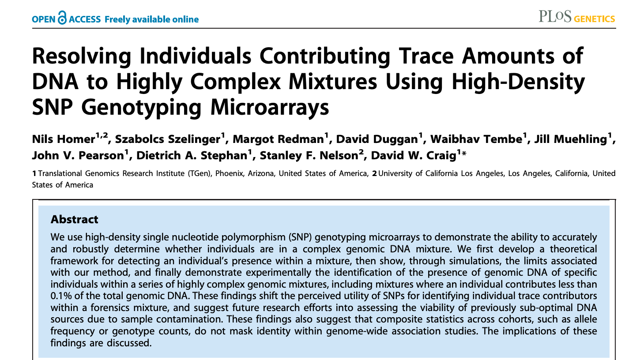
An Early Work
判断个人基因是否出现在一个复杂的混合基因里
可用于调查取证
Homer, Nils, et al. "Resolving individuals contributing trace amounts of DNA to highly complex mixtures using high-density SNP genotyping microarrays." PLoS genetics 4.8 (2008): e1000167.

Slide 9
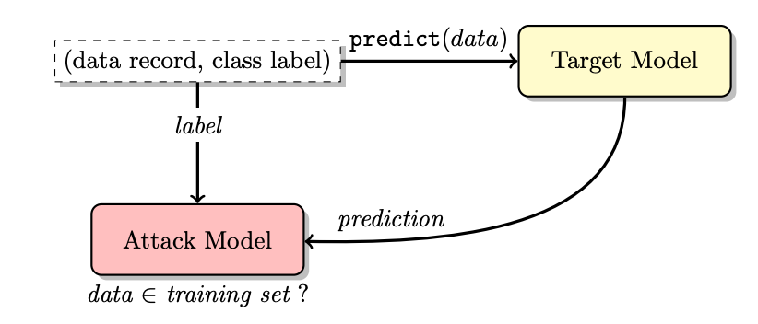
MIA：The Most Well-known Work
Needs probability vector
Black-box attack pipeline
Shokri, Reza, et al. "Membership inference attacks against machine learning models." S&P, 2017.0

Slide 10
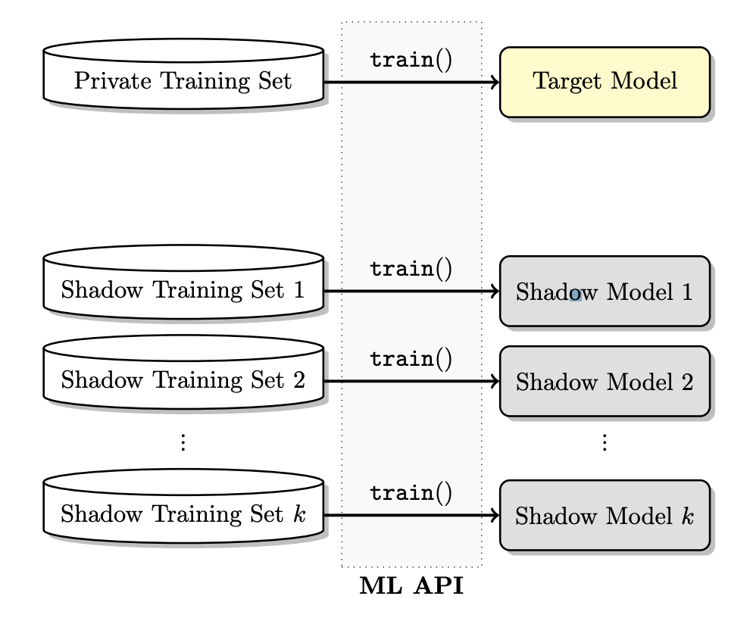
MIA：The Most Well-known Work
Sample a number of subsets from D
Train a model on each of the subset
Take one model as the target
Take the rest models as shadow models
Train k shadow models on disjoint datasets
Shokri, Reza, et al. "Membership inference attacks against machine learning models." S&P, 2017.

Slide 11
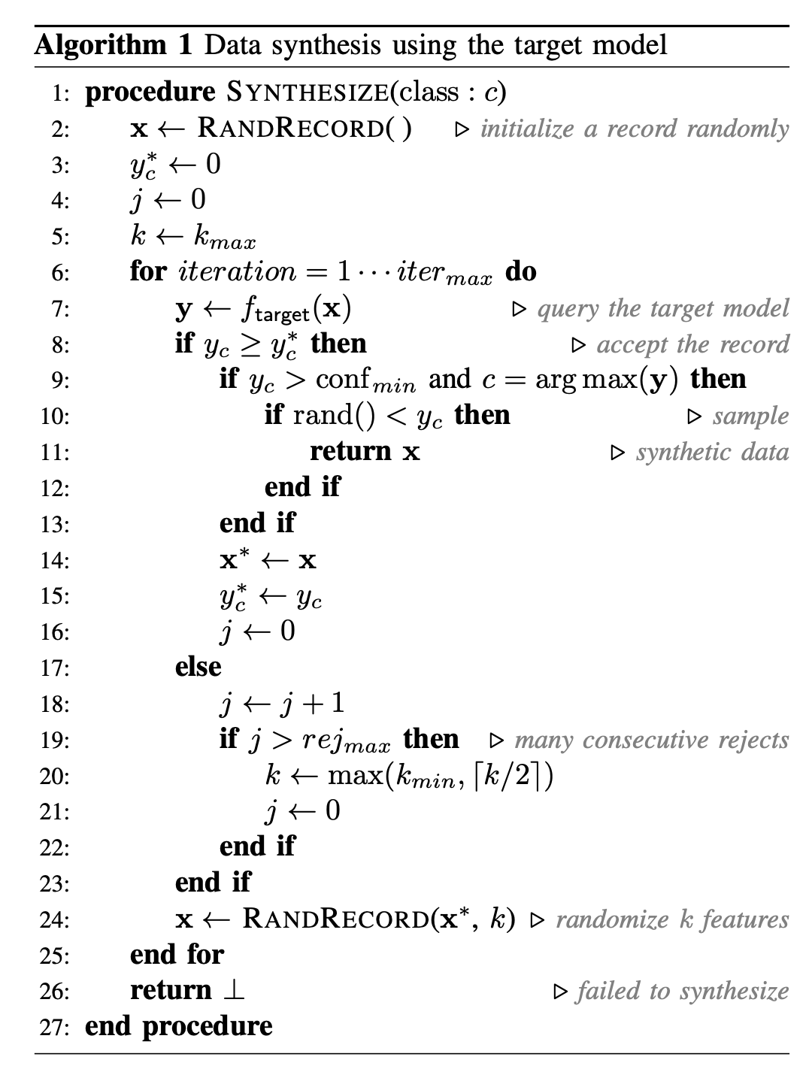
MIA：The Most Well-known Work
Different ways to get the training data：
Random Synthesis
Data synthesis
Phase 1: searching for high confidence data points in the data space
Phase 2: sample synthetic data from these points
Repeat the above for each class c
Phase 1: 每次只改变已找到的高置信度样本的k个特征
Shokri, Reza, et al. "Membership inference attacks against machine learning models." S&P, 2017.

Slide 12
MIA：The Most Well-known Work
Statistics-based synthesis
Prior knowledge:
The marginal distribution w.r.t. each class
Phase 1: sample according to the statistics
Shokri, Reza, et al. "Membership inference attacks against machine learning models." S&P, 2017.

Slide 13
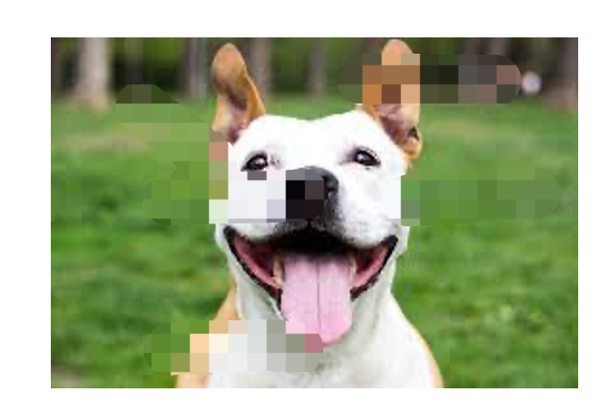
MIA：The Most Well-known Work
We could also assume the attacker can access Noisy Real data: real but noisy
Very similar to the real dataset
But with a few features (10% or 20%) are randomly reset
Shokri, Reza, et al. "Membership inference attacks against machine learning models." S&P, 2017.

Slide 14
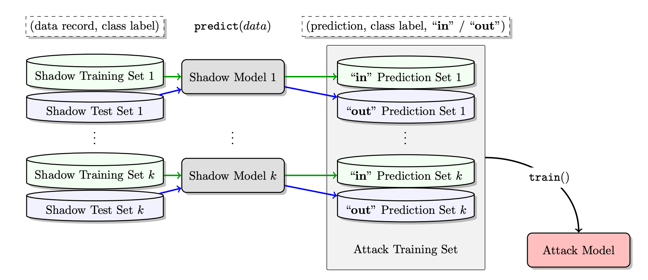
MIA：The Most Well-known Work
Finally: training the inference model
”in”: in the training set
”out”: : in the test set
Train the inference model with dataset: (prob1, ”in”), (prob2, ”in”), (prob3, ”out”)
(prob4, ”out”)
Shokri, Reza, et al. "Membership inference attacks against machine learning models." S&P, 2017.

Slide 15
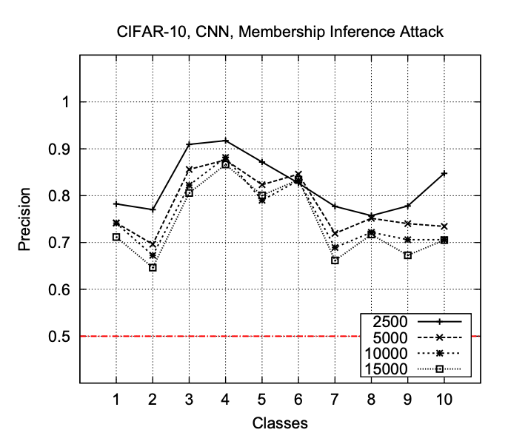
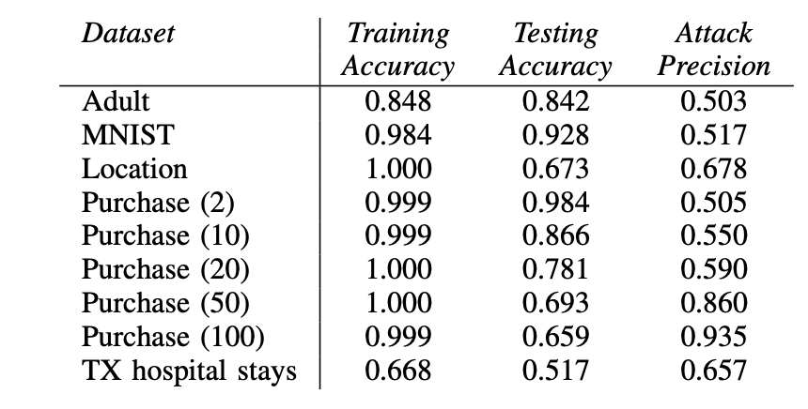
MIA：The Most Well-known Work
How well can MIA perform?
数据集：CIFAR-10、CIFAR-100、Purchases、Locations、Texas hospital stays、MNIST、UCI Adult (Census Income).
Shokri, Reza, et al. "Membership inference attacks against machine learning models." S&P, 2017.

Slide 16
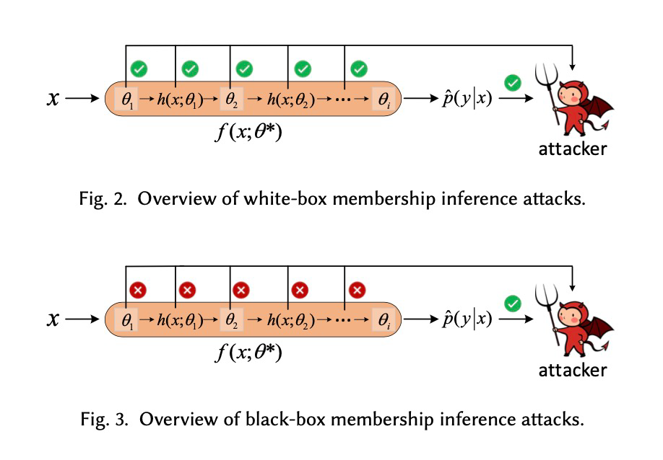
White-box MIA
White-box vs Black-box
Nasr et al. “Comprehensive privacy analysis of deep learning: Passive and active white-box inference attacks against centralized and federated learning.” S&P, 2019. Hu, Hongsheng, et al. "Membership inference attacks on machine learning: A survey." ACM Computing Surveys (CSUR) 54.11s (2022): 1-37.

Slide 17
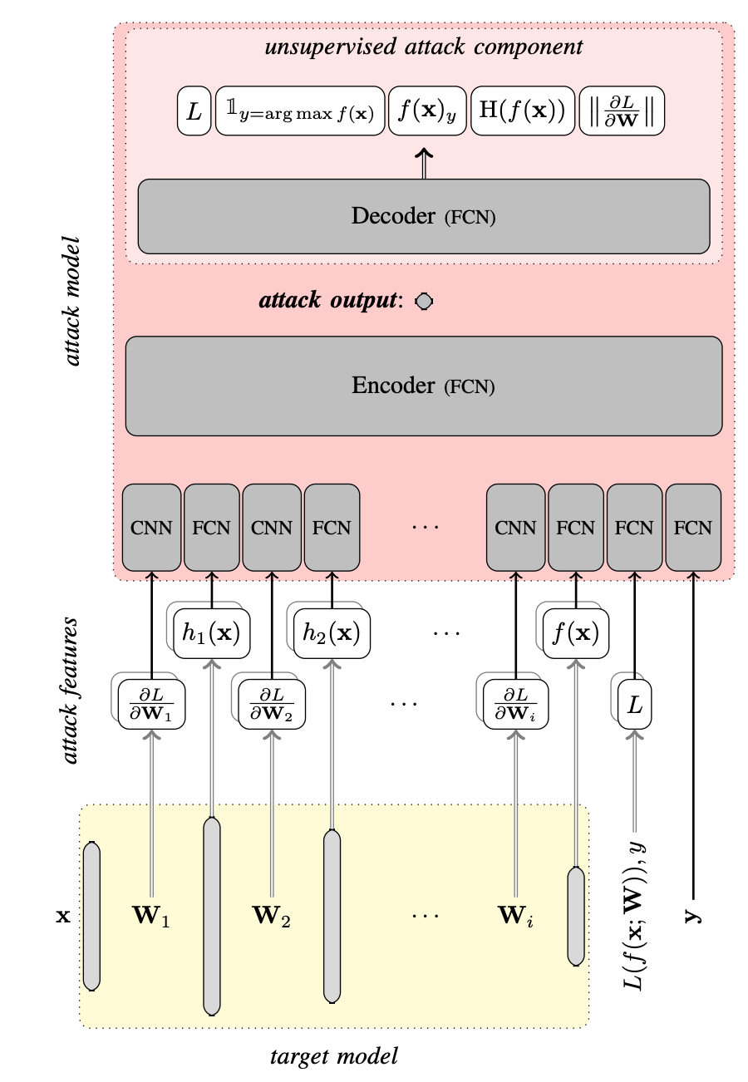
White-box MIA
无监督设置下的重构损失
推理结果
抽取特征：概率、中间层激活、梯度
Nasr et al. "Comprehensive privacy analysis of deep learning: Passive and active white-box inference attacks against centralized and federated learning." S&P, 2019.

Slide 18
Limitations of MIA
Constructing shadow models
Assuming access to some data or prior knowledge
Overfitting is a must
Limited to classification models
Limited to small models

Slide 19
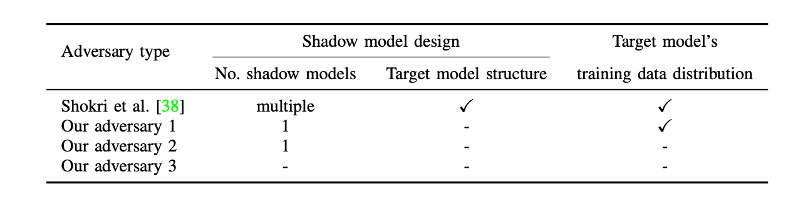
Addressing Limitations of MIA
Model and Data Independent MIA
Salem et al. "ML-Leaks: Model and Data Independent Membership Inference Attacks and Defenses on Machine Learning Models." NDSS, 2019.

Slide 20
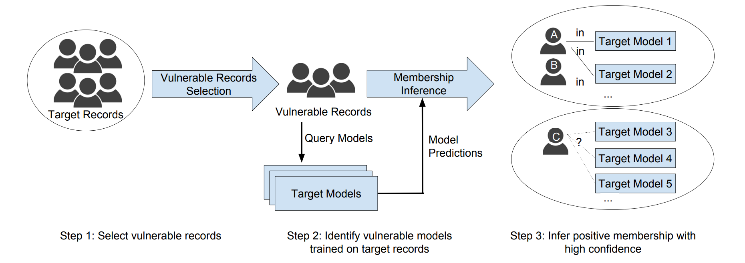
Addressing Limitations of MIA
Attacking non-overfitting DNNs
Focusing on minimizing false positives
目标问题：样本A/B在哪个模型的训练数据里？
Long, Yunhui, et al. "A pragmatic approach to membership inferences on machine learning models." EuroS&P, 2020.

Slide 21
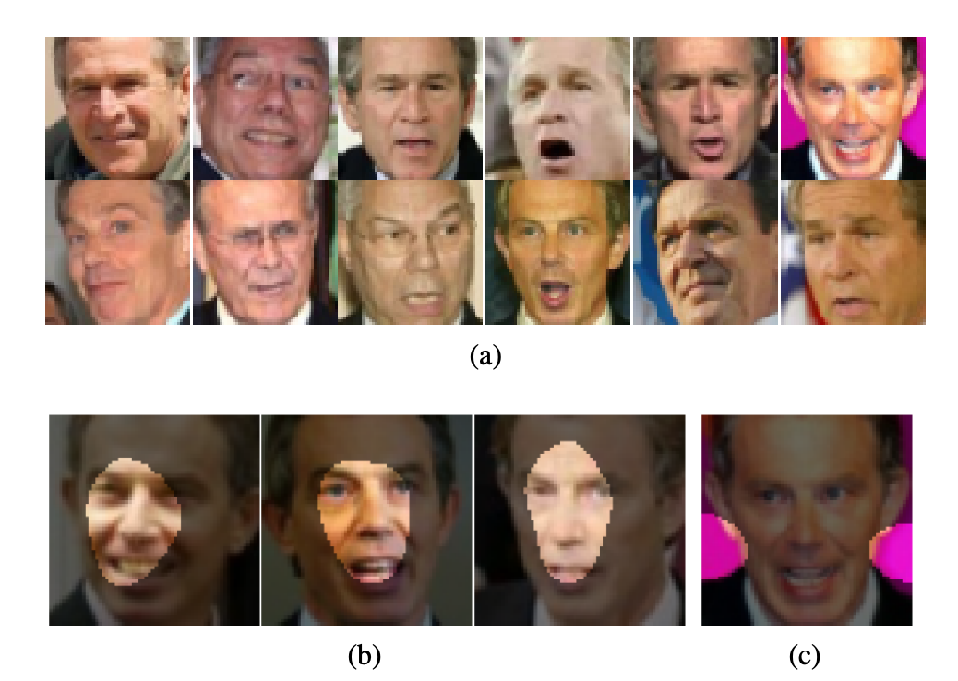
Addressing Limitations of MIA
More practical white-box threat model
The adversary only knows the model but not the data distribution
Training images
利用诡异的独家记忆进行成员推理
Internal explanations
Pink background explanation of Tony Blair
Leino & Fredrikson. "Stolen Memories: Leveraging Model Memorization for Calibrated White-Box Membership Inference." USENIX Security, 2020.

Slide 22
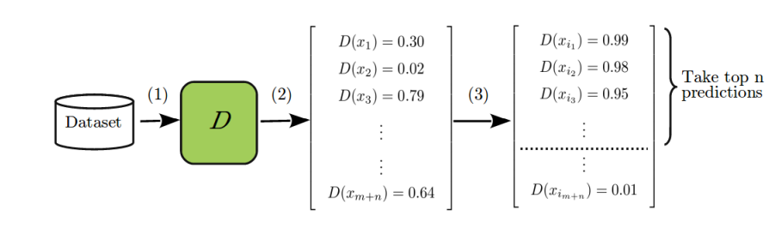
Addressing Limitations of MIA
Extension to generative models
充分利用判别器的判别能力：高置信度的大概率来自原始训练数据集
Hayes, Jamie, et al. "Logan: Membership inference attacks against generative models." arXiv preprint arXiv:1705.07663 (2017).

Slide 23

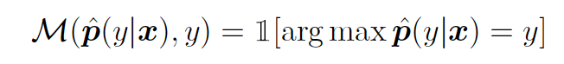
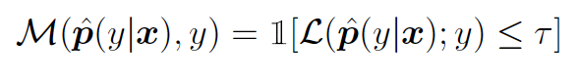
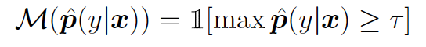
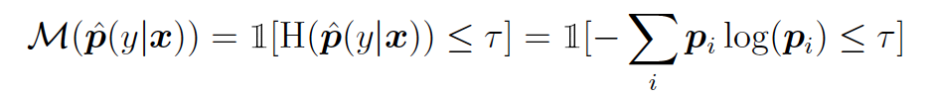
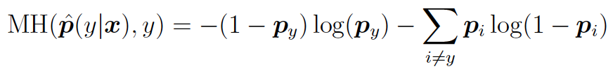
Metric-guided MIA
Metric based Anomaly detection
预测正确性：
预测正确的就是成员
预测损失：
高于训练样本平均损失的是成员
预测置信度：
有概率接近1的是成员
预测熵：
低概率熵的是成员
修正预测熵：
不同类别区别考虑
Yeom, Samuel, et al. “Privacy risk in machine learning: Analyzing the connection to overfitting.” CSF, 2018. Salem et al. "ML-Leaks: Model and Data Independent Membership Inference Attacks and Defenses on Machine Learning Models." NDSS, 2019.

Slide 24
A Summary of Existing MIAs
Used Datasets
Image:
CIFAR-10, CIFAR-100, MNIST, Fashion-MNIST, Yale Face, ChestX-ray8, SVHN, CelebA, ImageNet
Tabulate:
Adult, Foursquare, Purchase-100, Texas100, Location, etc.
Audio:
LibriSpeech, TIMIT, TED
Text:
Weibo, Tweet EmoInt, SATED, Dislogs, Reddit comments, Cora, Pubmed, Citesser
Hu, Hongsheng, et al. “Membership inference attacks on machine learning: A survey.” ACM Computing Surveys, 2022.

Slide 25
A Summary of Existing MIAs
Target models:
On image:
Multi-layer CNN + 1 or 2 FC (> 5 papers used 2-4 layers CNN)
Alexnet, ResNet18, ResNet50, VGG16, VGG19, DenseNet121, Efficient-netv2, EfficientNetB0
GAN: InfoGAN, PGGAN, WGANGP, DCGAN, MEDGAN, and VAEGAN
On tabulate data:
FC only models
On text:
Multi-layer CNN, multi-layer RNN/LSTM, transformers (e.g., BERT, GPT-2)
On audio:
Hybrid system: HMM-DNN model
End-to-end: Multi-layer LSTM/ RNN/GRU
MLaaS (Online):
Google Prediction API, Amazon ML

Slide 26
Membership Inference Attack
Differential Privacy

Slide 27
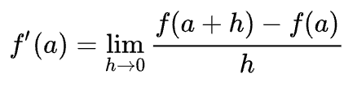
Differential Privacy
Finite Difference and Derivative
h tends to be small (zero)
通过函数在某一点随微小扰动的变化可以估计在这一点的梯度
如果对数据集进行微小扰动呢？

Slide 28
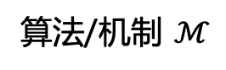
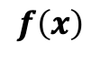
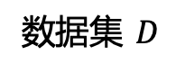
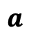
Differential Privacy
Finite Difference -> Differential Privacy
$$f\left(x\right)$$
函数
算法/机制 $ℳ$
$$a$$
输入值
数据集 $D$
数据集的微小变化会导致多大的算法输出变化？

Slide 29
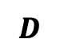
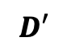
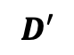
Differential Privacy
邻接数据集 $D$、 $D′$
$$D$$
$$D′$$
$$D′$$
数据集的微小变化会导致多大的算法输出变化？

Slide 30
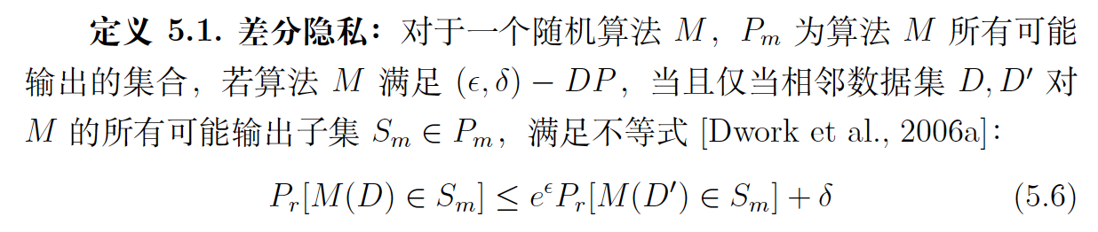
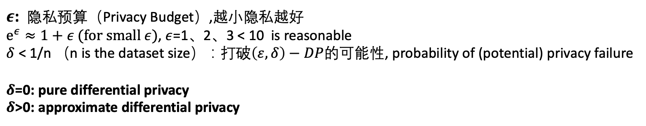
Differential Privacy
$ε$: 隐私预算（Privacy Budget）,越小隐私越好
$e^{ε}≈1+ε (for small ε)$, $ε$=1、2、3 < 10 is reasonable
$δ$ < 1/n （n is the dataset size）：打破$\left(ε,δ\right)−DP$的可能性, probability of (potential) privacy failure
$δ$=0: pure differential privacy
$δ$>0: approximate differential privacy
Dwork, Cynthia. "Differential privacy: A survey of results." ICTAMC, Heidelberg, 2008.

Slide 31
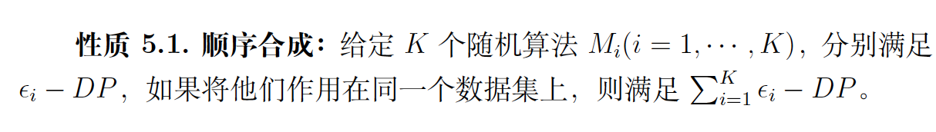
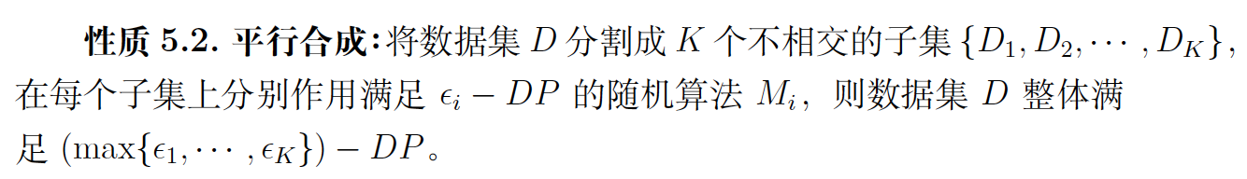
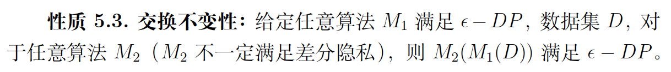
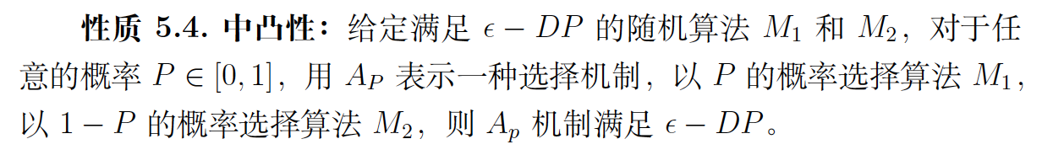
Properties of DP
McSherry, Frank D. “Privacy integrated queries: an extensible platform for privacy-preserving data analysis.” ACM SIGMOD, 2009.

Slide 32

How to Obtain a Differentially Private Model?
思考：如何让自己的声音不被发现？？

Slide 33
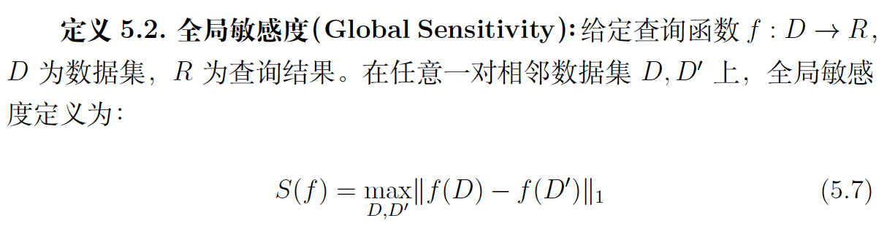
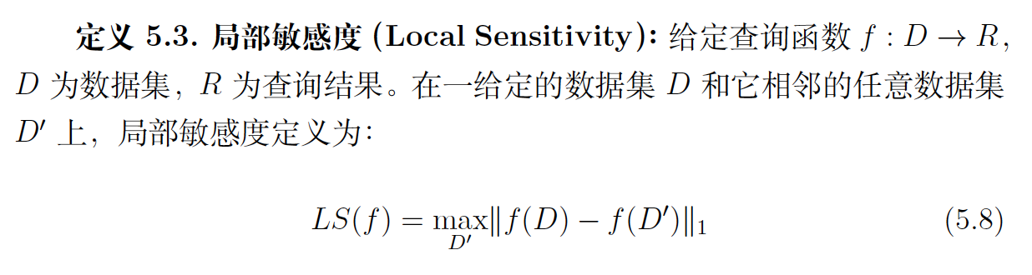
Measuring Sensitivity
Nissim and Adam. “Smooth sensitivity and sampling in private data analysis.” STOC, 2007.

Slide 34
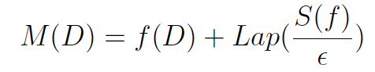
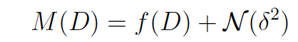
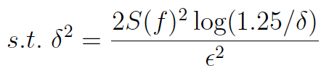
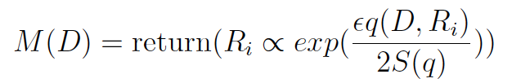
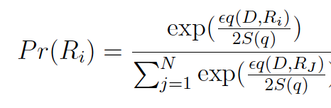
Noise Models
几种噪声添加机制
拉普拉斯机制 (Laplacian)
高斯机制 (Gaussian)
指数机制：离散 -> 概率；确定 -> 不确定

Slide 35
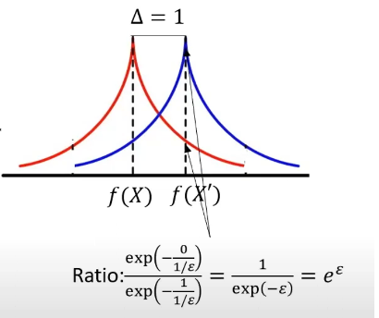
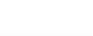
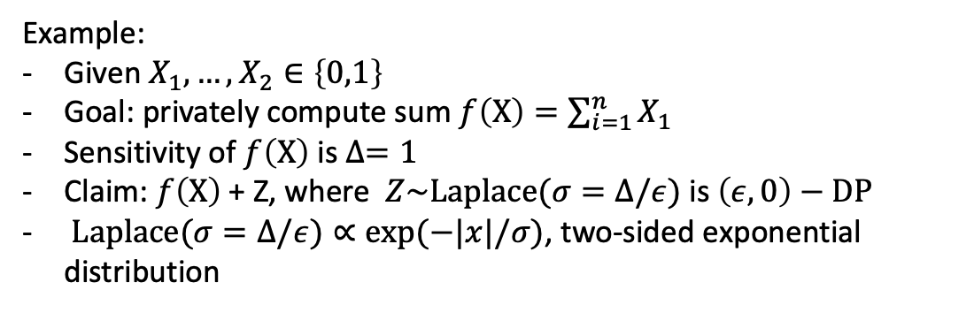
The Laplace Mechanism
拉普拉斯机制 (Laplace Mechanism)
Example:
Given $X_{1},…,X_{2}∈\left\{0,1\right\}$
Goal: privately compute sum $f\left(X\right)=\sum_{i=1}^{n}{X_{1}}$
Sensitivity of $f\left(X\right)$ is $∆=1$
Claim: $f\left(X\right) \text{+} \text{Z}$, where $Z\sim Laplace(σ=∆/ε)$ is $\left(ε,0\right)−DP$
$Laplace(σ=∆/ε)∝exp⁡(−|x|/σ)$, two-sided exponential distribution
SaTML 2023 - Gautam Kamath - An Introduction to Differential Privacy

Slide 36
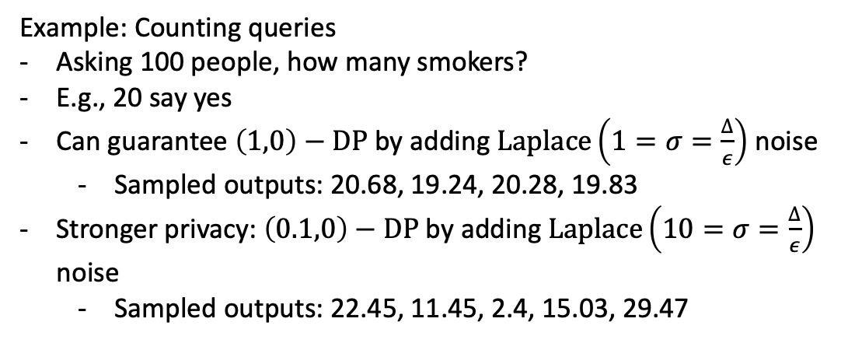
The Laplace Mechanism
拉普拉斯机制 (Laplace Mechanism)
Example: Counting queries
Asking 100 people, how many smokers?
E.g., 20 say yes
Can guarantee $\left(1,0\right)−DP$ by adding $Laplace\left(1=σ=\frac{∆}{ε}\right)$ noise
Sampled outputs: 20.68, 19.24, 20.28, 19.83
Stronger privacy: $\left(0.1,0\right)−DP$ by adding $Laplace\left(10=σ=\frac{∆}{ε}\right)$ noise
Sampled outputs: 22.45, 11.45, 2.4, 15.03, 29.47
SaTML 2023 - Gautam Kamath - An Introduction to Differential Privacy

Slide 37

The Laplace Mechanism
Given a funciton $f\left(X\right):𝒳^{n}→ℝ^{d}$
Let $∆_{1}^{f}=\max_{X,X^{′}differ in one entry}{{\left\|f\left(X\right)−f\left(X^{′}\right)\right\|}_{1}}$be $l_{1}−sensitivity$ of $f$: how much can the function change by modifying one data point
Theorem: the Laplace Mechnism $f\left(X\right)+Lap{\left(∆_{1}^{f}/ε\right)}^{⨂d}$ is $\left(ε,0\right)$-DP
Adding Laplace noise to each coordinate, proportional to the $l_{1}$- $sensitivity$
SaTML 2023 - Gautam Kamath - An Introduction to Differential Privacy

Slide 38


Laplace vs. Gaussian
Both add noise to $f\left(X\right)$
Gaussian often adds less noise than Laplace
As sensitivity is based on $l_{2}$- $sensitivity<l_{1}\text{− }sensitivity$
But Gaussian gives $\left(ε,δ\right)$-DP rather than Laplace’s $\left(ε,0\right)$-DP
Weaker privacy
Most of the time, $\left(ε,δ\right)$-DP is good enough
Necessary if you’re doing a lot of queries on the same datasets
“Advanced composition”
SaTML 2023 - Gautam Kamath - An Introduction to Differential Privacy

Slide 39

DP + Deep Learning
问题：在哪里添加噪声？
输入空间
模型空间
输出空间

Slide 40

输入空间DP
差分隐私预处理训练数据
dp-GAN pipeline
Zhang et al. “Differentially private releasing via deep generative model (technical report).” arXiv:1801.01594 (2018).

Slide 41

输入空间DP
随机平滑 Randomized Smoothing
用随机噪声填充输入空间，得到对抗鲁棒性边界
随机平滑：可验证对抗防御
Cohen, Jeremy, Elan Rosenfeld, and Zico Kolter. "Certified adversarial robustness via randomized smoothing." ICML, 2019.

Slide 42

模型空间DP
差分隐私平滑模型参数：DP-SGD算法
Abadi, Martin, et al. “Deep learning with differential privacy.” CCS, 2016.

Slide 43

DP-SGD性能
SaTML 2023 - Gautam Kamath - An Introduction to Differential Privacy

Slide 44

DP-SGD性能
SaTML 2023 - Gautam Kamath - An Introduction to Differential Privacy

Slide 45

DP-SGD性能
SaTML 2023 - Gautam Kamath - An Introduction to Differential Privacy

Slide 46

More Practical Solution?
1: Training on public data like ImageNet
2: Finetuning with DP-SGD on private data
SaTML 2023 - Gautam Kamath - An Introduction to Differential Privacy

Slide 47


输出空间DP
差分隐私扰动目标函数：多项式目标函数
回归模型
根据Stone-Weierstrass 理论：任意连续可微的函数可表示为：
Zhang, Jun, et al. “Functional mechanism: regression analysis under differential privacy.” arXiv:1208.0219, 2012. Rudin, Walter. Principles of mathematical analysis. Vol. 3. New York: McGraw-hill, 1976.
Notes:
斯通-魏尔斯特拉斯定理是泛函分析中的一个定理。他指出任何一个连续函数都可以用一系列的多项式函数来近似表示，由德国科学家卡尔.魏尔斯特拉斯提出。泰勒基数，任何一个函数都可以用泰勒级数来表示。

Slide 48

输出空间DP
差分隐私扰动目标函数：多项式目标函数
Zhang, Jun, et al. “Functional mechanism: regression analysis under differential privacy.” arXiv:1208.0219, 2012.

Slide 49

输出空间DP
差分隐私扰动目标函数：cross-entropy
泰勒展开 Taylor Expansion
Phan, et al. “Differential privacy preservation for deep auto-encoders: an application of human behavior prediction.” AAAI, 2016.

Slide 50
尚存挑战
Attack:
Better Performance Metrics for MIA
Attacking large-scale pretrained models
Defense:
How to achieve both accuracy and privacy
How to detect potential MIAs on the fly

Slide 51
谢谢！

